Slide 1
INVESTMENT OPPORTUNITIES IN THE BRAZILIAN GAS INDUSTRY
ANELISE QUINTÃO LARA
September 15th 2020
1

Slide 2
Brazilian gas production has followed oil production growth
PRE-SALT
ULTRA DEEP WATER
DEEP WATER
SHALLOW WATER
ONSHORE
Source: Petrobras PNG 20-24

Slide 3
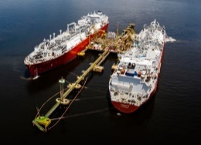
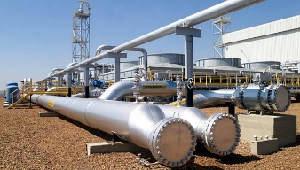
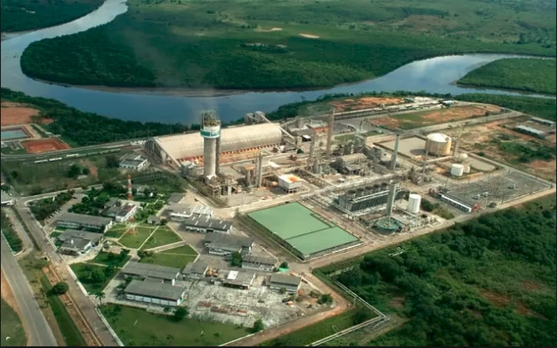
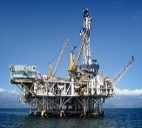
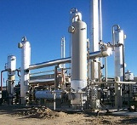
Natural gas supply and demand overview
Import
Transportation Infrastructure
Market
Supply capacities
Thermal power plants
Daily Average Consumption 2019: 23,6 MMm3/day
Daily Maximum Consumption 2019: 38,1 MMm3/day
LNG regasification terminals
Overall Capacity: 41 MM m³/day
Daily Average Volume 2019: 8,2MMm3/day
Daily Maximum Volume 2019: 18,8 MMm3/day
Own consumption
TAG
NTS
Pipeline from Bolivia
Overall Capacity: 30 MM m³/day
Daily Average Volume 2019: 17,9 MMm3/day
Daily Maximum Volume 2019: 31,0 MMm3/day
TBG
TSB
Daily Average Consumption 2019: 13,5 MMm3/day
Daily Maximum Consumption 2019: 16,3 MMm3/day
Gás Ocidente
Non-thermal demand
National Production and Processing
Flare
Reinjection
Liquids
Daily Average Consumption 2019: 38,2 MMm3/day
Daily Maximum Consumption 2019: 41,7 MMm3/day
Production
Production from partners
National Production
Daily Average Volume 2019: 50,4 MMm3/day
Daily Maximum Volume 2019: 51,7 MMm3/day
Natural gas
processing plants

Slide 4
Demand by type of consumption and geographic region January 2020
Total national daily demand
81.8 MM m³ / day
North region
N region: 5.4 MM m³ / day
Northeast region
NE region: 15.2 MM m³ / day
Midwest region
MW region: 1.9 MM m³ / day
Southeast region
Key
Power
Industry, vehicles, residential, others
Internal (Petrobras)
South region
SE region: 51.1 MM m³ / day
S region: 13.1 MM m³ / day
Source: Petrobras

Slide 5
Domestic production to grow until 2030, but Brazilian market remains net importer with power demand growth
Source: EPE – PDE 2029

Slide 6
Recent Developments on the Brazilian Natural Gas Regulatory Framework
In 2020, it will be discussed at the lower house the bill 6,407 / 2013 which foresee regulations for the opening of the natural gas market in its different segments
CNPE Resolution (16 / 2019)
Settlement between PETROBRAS and CADE to reduce the company’s footprint in the market
TCC - Commitment Term between CADE and Petrobras
Decree 9,616 (12/18): Guidelines for the natural gas market regulation
New Gas Law bill submitted to Congress, replacing the previous from 2013
Launch of the “Gás para Crescer” program
CNPE Guidelines for “Gás para Crescer” work fronts
2020
2019
2018
2016
2017

Slide 7
TCC - Commitment Term between CADE and Petrobras
In July 2019, the Administrative Council for Economic Defense (CADE) signed an important agreement with Petrobras, outlining a set of planned actions to increase competition in the Brazilian Gas Market
Divestments (Full Unbundling)
Marketing Opening
Natural Gas Transmission Companies
NTS: 10% (teaser released)
TAG: 10% (concluded)
TBG: 51% (in progress)
Shares in NG distribution companies
(teaser released)
Access to gathering and processing infrastructure
(website released – negotiations on going)
Access to transport gas capacity (capacity already informed, release to be negotiated with transcos)
Lease of Bahia Regas Terminal
(teaser released , to be concluded by sept/20)
Reduction of new natural gas purchases

