Slide 1
Presentation Br-Am Chamber of Commerce Marcelo Kfoury Muinhos
FGV-EESP

Slide 2
Introduction
First, I would like to thanks Paulo for inviting me to talk here this afternoon.
I will focus my talk in Monetary policy that has been my specialty for the last 25 year.
After controlling inflation with the launch of the Real plan in 1994, Brazil has finally been able to converge the real interest rate to a new level close to zero at the end of 2019s, just before the pandemic.
The Real plan has stabilized inflation indeed, but it has produced two collateral effects:
Increasing tax revenue
Extremely high interest rate
Nowadays, when we are at the end of the easing cycle, central bank policy rate (Selic rate) is at record low level at 2%. The effective real interest rate (360-PreDI Swap discount by 12-month inflation expectation) reached -0.75% in June 2020 the lowest level ever, and it was at the end of September is slightly below zero.
Notes:
.

Slide 3
Introduction
I have been working with equilibrium rate since I was in the Central Bank 15 years ago. When I left Citi I kind of resume this work.
Given there is still idle capacity in the economy, it is possible that the effective rate is below the equilibrium rate. Hence, two questions that naturally follows:
what is the equilibrium rate?
is it the monetary policy accommodative indeed and it is stable or will be revert soon?

Slide 4
Equilibrium Rates Results
I just released two paper related to the topic.
The first one using econometric techniques to calculate the equilibrium rate and
https://eesp.fgv.br/sites/eesp.fgv.br/files/equilibriumrates3aprset20.pdf
the second one using a DSGE model, which is a General Equilibrium partially estimated with a Bayesian econometric approach and partially calibrated.
https://eesp.fgv.br/sites/eesp.fgv.br/files/dsgejurosdeequilibriobrasil.pdf
The results are robust, and we found that lately the equilibrium rate lies between 1% and 3%.
In the first paper, we also estimate a Taylor rule for Brazil.
When we add The Talor rule, the effective rate and an average of the equilibrium rate, the results are very exciting.
I could not resist to present a picture with it.

Slide 5
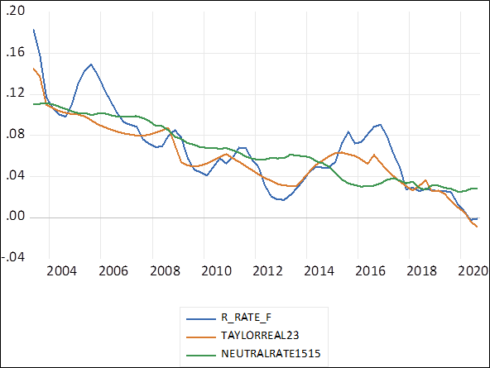
Interest Rate: Taylor Rule and Equilibrium Rate
The blue line is the effective real interest rate, the green the equilibrium rate and the orange is the ones predicted by the Taylor Rule
In 2012, effective real rate was below the Taylor rule and from the average rate as well.
In the period of 2014-2016, effective rate was significantly higher than both rates, which might have aggravated the recession in the period.
Since 2019, the effective rate is significantly below the average and slightly below the Taylor rate, which means an expansionary monetary policy lately.
The real interest rate based on the this estimated Taylor rule should be in the 20Q3 at -0.8%.
Sources: MK4

Slide 6
Equilibrium Rates Results
The effective rate is significant below the neutral rate, about 200bps. But it could be more if we have a better fiscal stance according to the estimated Taylor rule.
But since June, the effective rate one-year rate has been increased because of the fiscal stance

Slide 7
This monetary policy stance is temporary or permanent
Central Bank communication is trying to give a message that the monetary policy will be accommodative in the short/medium term, because inflation forecast for 2021 is still comfortably below the target. This message is kind of conveying in my given estimation of the Taylor rule.
But the forward guidance that Central depends upon the fiscal scenario.
The best one to determine the country risk is not the CDS-5Y anymore but the slope of the interest rate yield curve

Slide 8
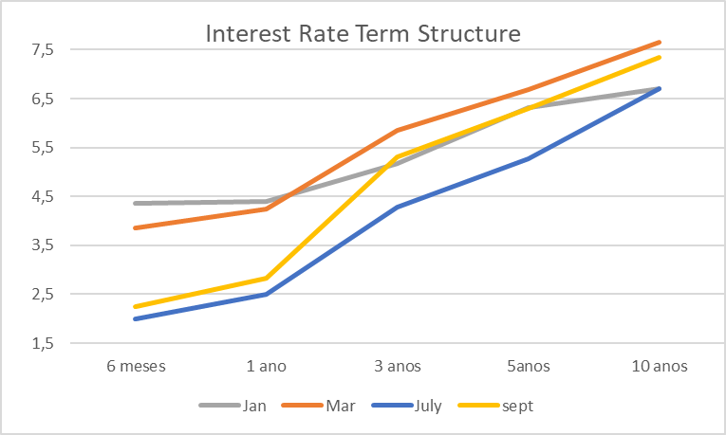
Interest Rate: Taylor Rule and Equilibrium Rate
Sources: MK4
The slope is 4pp when one compares 6months with 5 years and 5 pp between 6 months and 10 years. In January, before the pandemic hit Brazil the slop was 2pp.
In the long end, the 10-year yields is greater now than in January, before the easing cycle causing by Pandemic.
The slope has increased since July 80 bps points and CDS-5year is about the same.

Slide 9
This monetary policy stance is temporary or permanent
Because the risk is not in the external debt but in the domestic debt.
So the first major risk to the inflation scenario in my opinion is the fiscal one.
I will let my colleagues to talk more about that. I think that have comparative advantages in deciphering the numbers.
And given the fiscal number, it is not orthogonal to monetary policy, we can discuss if Central Bank has over cut the Selic rate. I think so.
The discount on the LFTs are also sign that market is not 100% comfortable with Selic at 2%. I am not going deep on the technicalities of the auctions, but since 2002 we have seen the Treasury having a hard time to refinance public debt.
Higher rates at the long and middle section of the yield curve forced the shortening of debt profile.
Thus, putting a lot of pressure in next quarter debt refinancing. There are R$600billion reais to roll over in the first quarter of 2021.

Slide 10
This monetary policy stance is temporary or permanent
Another risk to monetary policy is the dual economy growth.
We see retail sale and industrial sector soaring and service sector sinking.
Inflation number is reflecting this dual behavior and on the top of that we have a shock in food and raw material causing by China.
The wholesale prices are around 20% in the accumulated 12-month.
So far, this scenario has not contaminated the 2021 inflation forecast, although we have seen major revision this year.
A couple of months ago, most of the Copom followers said that Central Bank president would have to write an open letter to the Finance minister, because inflation would breech the inflation targeting interval from below.
It looks like it is not the case anymore. Inflation expectation for 2020 are already close to 2.5%.

Slide 11
This monetary policy stance is temporary or permanent
But this pass through from wholesale prices to retail are already happening but at a moderate pace, given the weight of service prices in inflation around 35% and the recession.
Utility prices are also holding inflation at bay.
But if we see another round of BRL depreciation due to fiscal slippage or a pickup in the service sector level off with other sectors, the passthrough will increase and will damage inflation expectation.

Slide 12
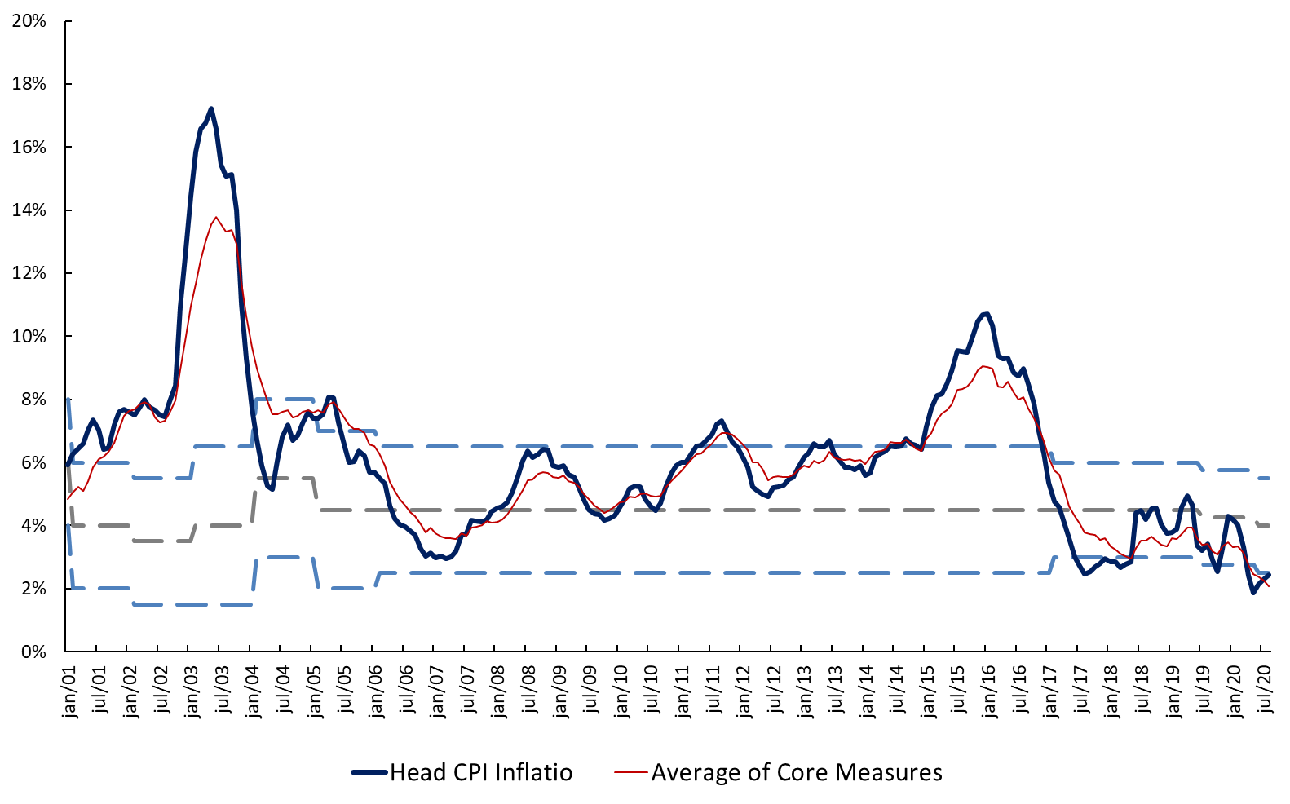
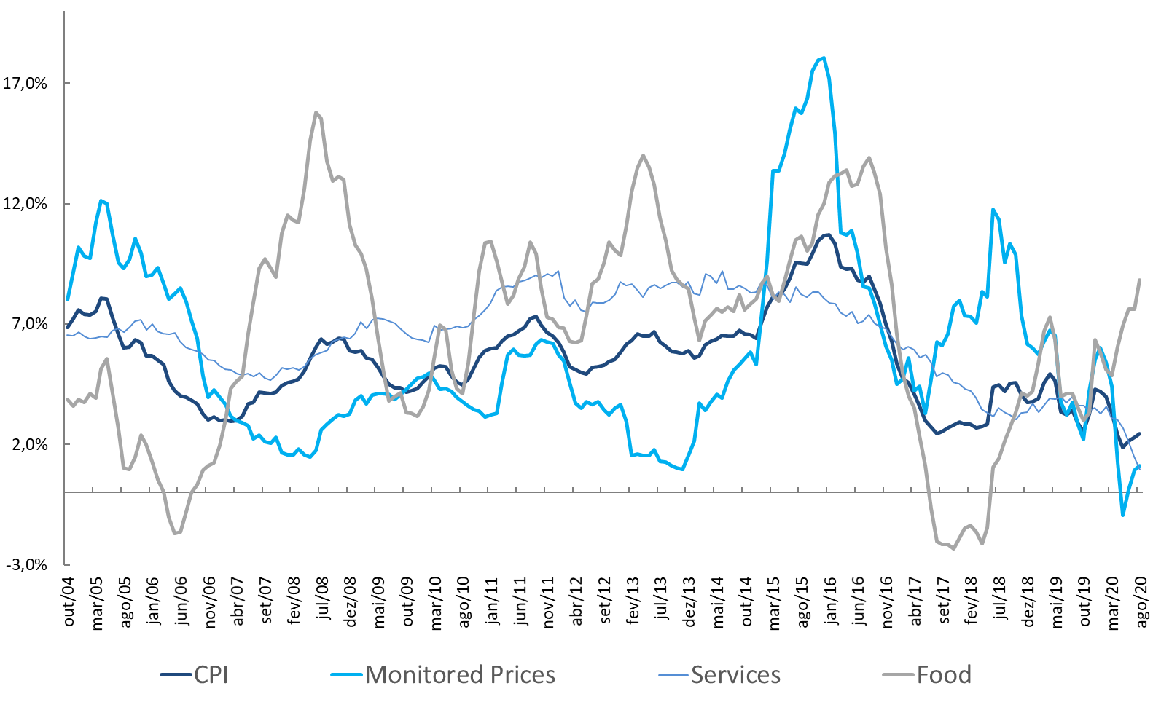
Inflation – For the Second Time below the target
CPI Inflation and Targets (YoY)
CPI Breakdown (YoY)
Sources: IBGE, BCB
Sources: IBGE
For the second time in the history of inflation targets policy, BCB is likely to write a letter for not fulfilling the target from below.
The 12-month accumulated inflation is at 1.9% and the 12-month core average a 2.8%.
Food inflation is back to the positive camp since the surging in December 2019 because meat surged. (6.9% in May 20)
Service inflation had averaged 8.1% between 2011 and 2016, and it is now growing at 2.7% in May 2020
Monitored prices has been negative recent months

